Slide 1

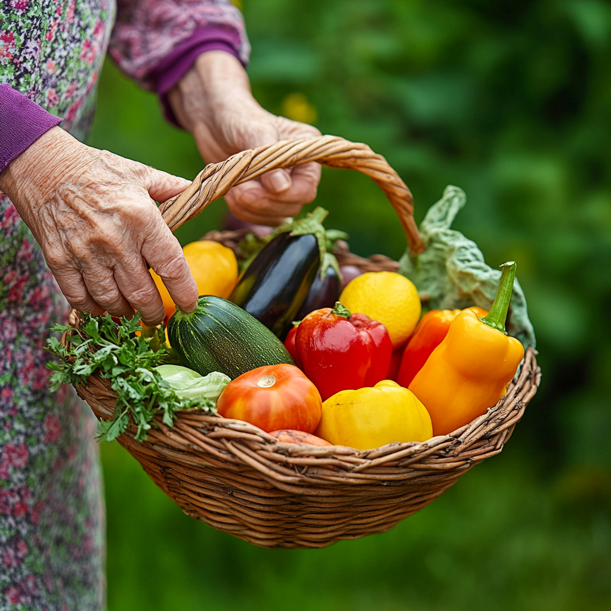
SkyRoot Business Plan
汇报人：AiPPT

Slide 2
CONTENTS
01
02
03
Project Background
Market Research on Agricultural Product Live Streaming
Project Core Value
04
05
Core Risk Analysis
Future Vision and Strategic Path

Slide 3

Policy Foundation
Central Document No.1
The project is inspired by the Central Document No.1 in 2025, which emphasizes "new quality productivity in agriculture and technology empowerment" and "integration of rural e- commerce and cross- border e- commerce".
It aligns with the eight policy supports for agricultural products under the new e- commerce law.

Slide 4
Market Potential
Agricultural E-commerce Boom
The transaction scale of agricultural e- commerce reached 1.2 trillion yuan in 2023, with a growth rate of 18.7%, showing strong market potential.
68% of consumers worry about the quality of agricultural products in live streaming, and only 35% trust the inspection reports provided by merchants.
The penetration rate of agricultural product live streaming reached 42%, indicating a promising trend in this field.
This highlights the urgent need for traceability technology to enhance consumer trust.
​​Agricultural E-commerce Economy Thrives​
Emerging Opportunities in Agricultural E-commerce

Slide 5







Existing Products Analysis
Product Comparison
Core Features: Short video-embedded traceability links Basic blockchain-based certification Critical Limitation: Limited data dimensions​​ – solely covers logistics and inspection reports
TikTok (Douyin) E-commerce Traceability Tools​
Tencent Anxin Platform​
Core Features: Blockchain-based traceability (integrated with WeChat ecosystem) Basic AR scan-to-view reports Critical Limitations: Static AR display only​​ – No dynamic growth process rendering ​​Lacks agricultural lifecycle visualization​​ – Limited to pre-loaded static images
Core Features: Real-time dialect-to-standard speech conversion Basic AR sticker effects Critical Limitations: No product recognition capability​​ – AR lacks item-specific interaction. ​​Generic script templates​​ – Limited customization for agricultural contexts.
​​Kuaishou Nongren Livestream Assistant​

Slide 6
Project Content and Positioning
01
Core Concept
02
Project Positioning
The project aims to assist farmers in live streaming by providing real- time speech generation, blockchain traceability display, and AR feature recognition.
It is positioned as an agricultural live streaming intelligent auxiliary SaaS platform, with the core philosophy of "technology empowerment, trust reconstruction, and value sharing".

Slide 7
Core Functions
AR Feature Recognition
Blockchain Traceability
Real-time Speech Generation
Utilizes TensorFlow Lite and ARKit to achieve 0.8- second rapid recognition with 98% accuracy. Supports dynamic growth rendering and multi- modal interaction, enhancing user experience.
Breakthroughs in high- frequency data processing and cross- chain recognition ensure data compliance and transparency. Consumers can scan to view a 3D supply chain map with detailed records.
Generates speech based on real- time sensor data and includes a risk control system to ensure compliance. Enhances emotional engagement through voice synthesis technology.

Slide 8
​​Critical Risk Analysis & Mitigation​
Platform Policy Ban Risk​​
01
Description: TikTok/Kuaishou restrict 3rd-party tool APIs. Impact: Lose >80% traffic channels → Business model collapse.
AI Script Compliance Risk​​
02
Description: Content violates ad laws (e.g., false claims). Impact: Fines up to ¥5M + permanent bans.
Cash Flow Crisis Risk
03
Description: Farmer payment reluctance (churn ↑ if >¥50/month). Impact: Year 1 revenue <¥30M vs. R&D cost ¥120M.
AR Recognition Failure Risk
04
Description: >20% error rate in complex scenes (rain/greenhouse glare). Impact: Scan rate drops from 40% → 15%.

Slide 9

Strategic Roadmap​
01
02
03
​​Phase 1: Tool Dominance (0-18mo)​
Phase 2: Ecosystem Orchestration (19-36 Months)​
Phase 3: Infrastructure Dominance (37-60 Months)​
Tech Anchors​​: AR-ID 3.0​​: 100+ crop recognition (<0.5s latency) ​​Blockchain Network​​: 500 nodes across key agricultural regions
Platform Expansion​​: ​​Open API Hub​​: Integrate third-party testing labs, logistics providers, and fintech partners ​​Agri-Data Exchange​​: Monetization via QST pricing model (Quality × Scarcity × Timeliness)
Industry Standardization​​: AgriOS​​: Embedded operating system for 100K+ smart farming devices ​​MetaFarm Nexus​​: Digital twin technology for 1:1 virtual-physical farm management

Slide 10
谢谢大家
汇报人：AiPPT

